Slide 1







Comparative Analysis of Telecommunication Companies' Stock Performance
A Year-Long Analysis of AT&T, T-Mobile, and Verizon
Presented by
Hunter Becker, Yara El-Emam, Kowsar Abdi, Sanjana Prabhakar, Adolphus Momoh Jr

Slide 2


Project Overview
Objective: To analyze and compare the stock performance of three major telecom companies (AT&T, T-Mobile, Verizon) over the past year from today
Importance: Provide insights to potential investors on the best-performing stocks based on historical data.
Data Fetching: Historical stock data was fetched using the yfinance library, which allows for easy access to financial data from Yahoo Finance
Methodology: Using Python and various financial analysis libraries to gather: Trend Analysis, Volatility Analysis, Correlation Analysis, Cumulative Returns, Candlestick Chart, Trading Volume Analysis, P/E ratio and Dividends
Notes:
Data Source: Yahoo Finance (via yfinance library)
Data Collected: Daily trading information including opening, closing, high, low prices, and trading volume
Ticker Symbols: We selected the ticker symbols for AT&T (T), T-Mobile (TMUS), and Verizon (VZ) to represent the companies in our analysis
Date Range: The analysis covers a one-year period, starting from one year ago to the present day
Data Fetching: Historical stock data was fetched using the yfinance library, which allows for easy access to financial data from Yahoo Finance
Data Organization: The data for each ticker was stored in a dictionary and then combined into a single DataFrame for further analysis
Add the analysis covered throughout the presentation

Slide 3
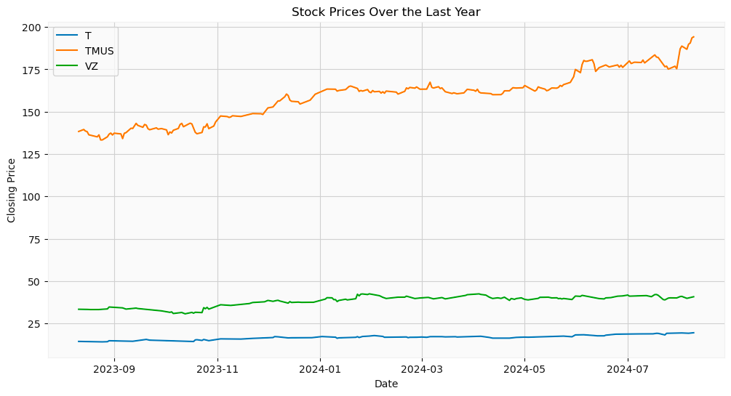

Trend Analysis
The trend analysis visualizes how the stock closing prices of AT&T, T-Mobile, and Verizon have changed over the past year
This helps identify any long-term patterns or significant events affecting the stock prices

Slide 4

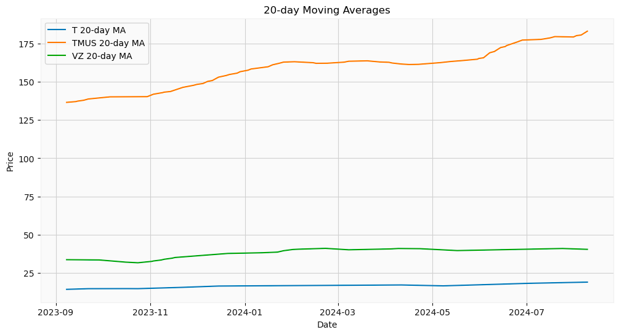
Moving Averages
20-day moving average for each stock to help identify short-term trends and smoothing out price fluctuations

Slide 5

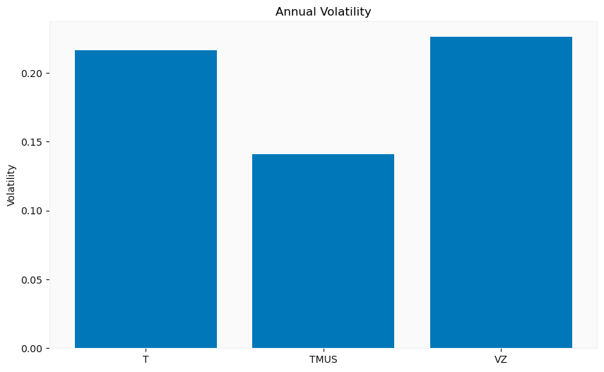
Volatility Analysis
Volatility analysis helps measure the risk associated with each stock by assessing how much the stock price fluctuates over time

Slide 6
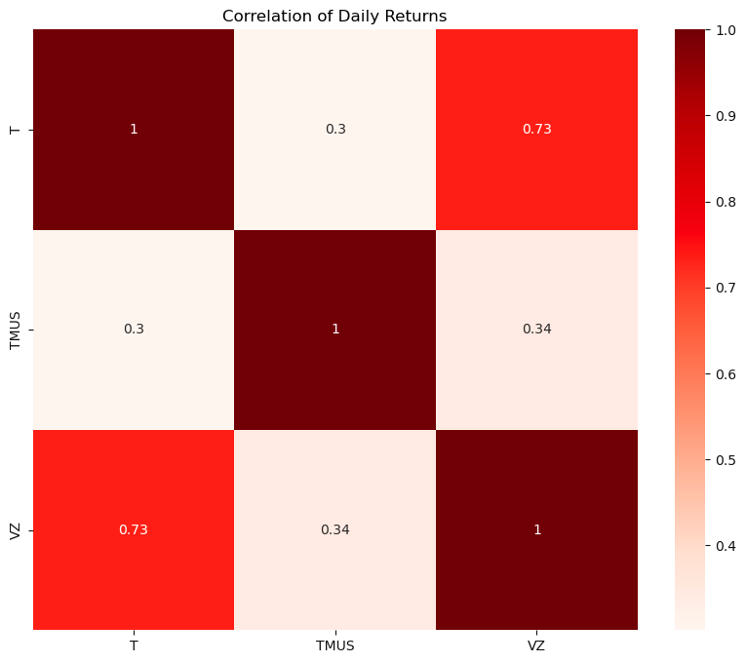

Correlation Analysis Using Heatmap
A heatmap visualizes data by using color variations to show the strength of relationships between variables.
T - TMUS has a weak positive correlation
T - VZ strong positive correlation
TMUS - VZ weak positive correlation
The correlation analysis reveals moderate positive correlations between the stocks, indicating that while they tend to move in the same direction, there is still some diversification benefit
Notes:
Explain what a heatmap is

Slide 7

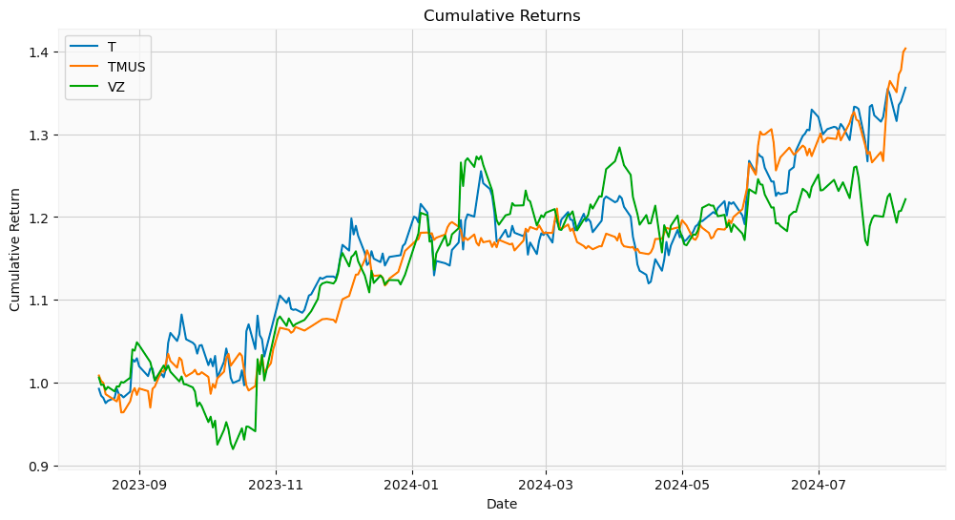
Cumulative Returns
Cumulative returns represent the total change in stock price over a given period, allowing investors to see how much an investment has grown or shrunk in value

Slide 8
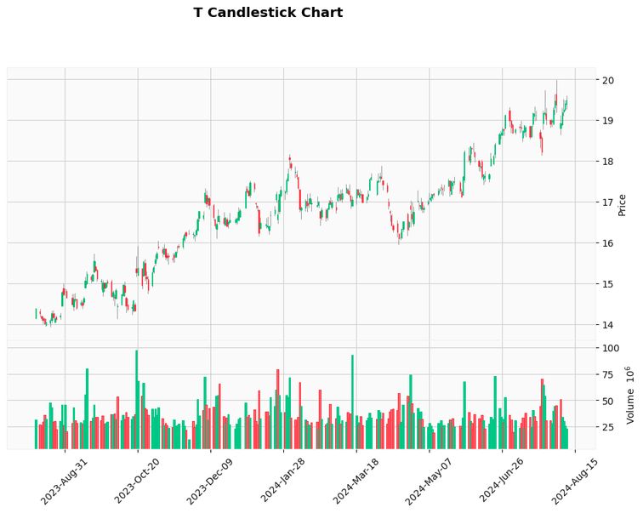
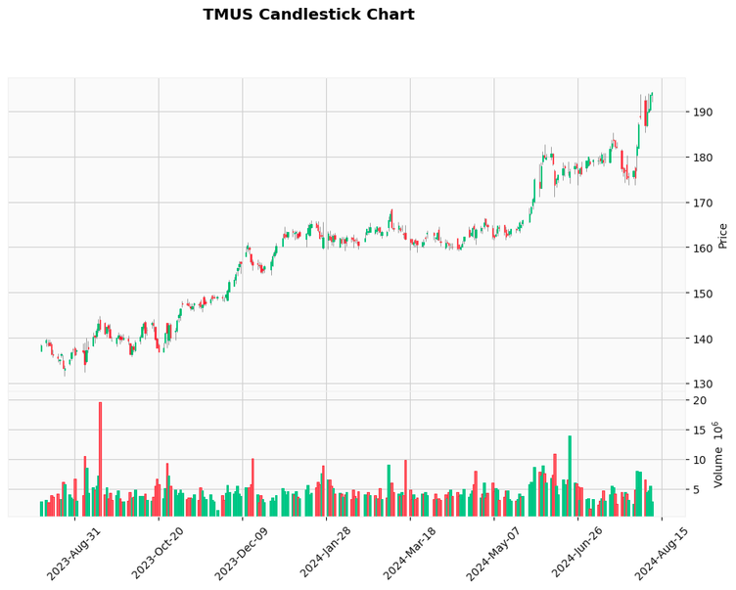
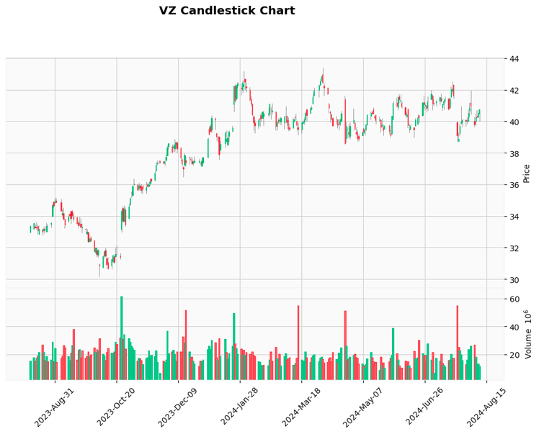
Candlestick chart
Candlestick charts provide a detailed view of daily stock price movements, including the opening, closing, high, and low prices
We created candlestick charts for each stock to visualize daily price fluctuations and overall market sentiment

Slide 9

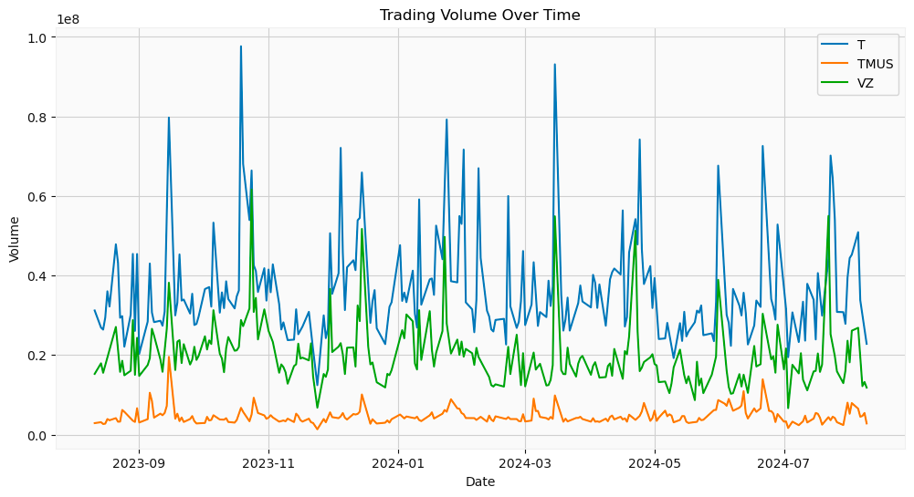

Trading volume analysis
Analyzing trading volume helps understand the liquidity of each stock and the level of investor interest
We visualized the trading volume for each stock over time to identify any significant spikes or trends

Slide 10
Key results
AT&T (T)
Start Price: 14.17
End Price: 19.49
Percent Change: +35.75%
Average Daily Return: 0.131%
Volatility: 21.63%
Dividend yield: 2.57
Earnings per share: 1.77
P/e ratio: 10.98
T-Mobile (TMUS)
Start Price: 137.72
End Price: 194.19
Percent Change: +35.67%
Average Daily Return: 0.137%
Volatility: 14.01%
Dividend yield: .03
Earnings per share: 8.10
P/e ratio: 23.96
verizon (vz)
Start Price: 32.02
End Price: 40.75
Percent Change: +23.67%
Average Daily Return: 0.094%
Volatility: 22.59%
Dividend yield: 1.59
Earnings per share: 2.67
P/e ratio: 15.24
Notes:
add Dividend and p ratio

Slide 11

Key insights
Best Performer: T-Mobile (TMUS) showed the highest cumulative returns and growth over the past year, making it the top performer among the three
Lowest Volatility: T-Mobile also had the lowest volatility, indicating it is the most stable investment option
Volume Trends: AT&T had the highest trading volume, reflecting strong investor activity
Cumulative Returns: The analysis shows that cumulative returns are highest for T-Mobile, reinforcing its position as the best-performing stock
Dividends: The correlation analysis between company dividend yields can tell us what stocks have the highest pay outs. A look at the P/E ratio will tell us if there is any possible problems with the stocks value..
Notes:
Add conclusion and limitation, future improvements

Slide 12
Recommendations, limitations, future improvements
Income-Oriented Investors: AT&T (T) may be suitable for steady dividends.
Growth Potential: T-Mobile (TMUS) is ideal for investors seeking higher growth potential due to its higher P/E ratio.
Balanced Choice: Verizon (VZ) offers a mix of dividends and growth potential, making it a balanced option.
Historical Data: The analysis is based on historical data and does not predict future performance.
Consider Additional Factors: Company fundamentals, market conditions, and external events should be considered for a comprehensive analysis.
Flexible Time Frame: The analysis time frame could be extended or shortened to observe different trends.

Slide 13

Thank You for Listening!
Questions?

